Slide 1
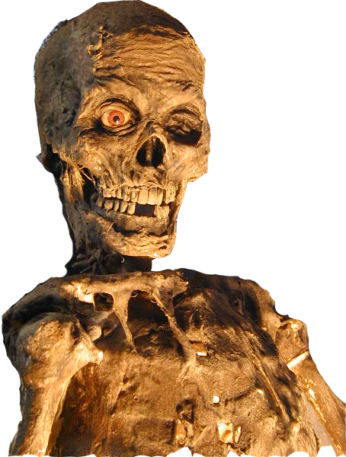
Death by PowerPoint

Slide 2
A presentation is a performance with purpose.

Slide 3
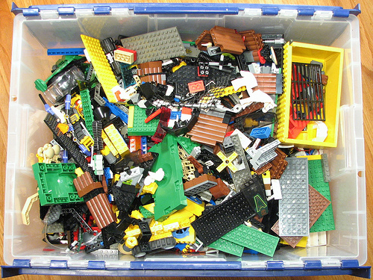
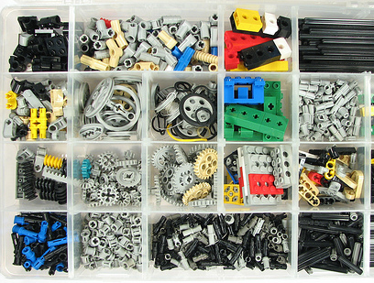
Presentation Rules to Live By
Presentations need structure.

Slide 4
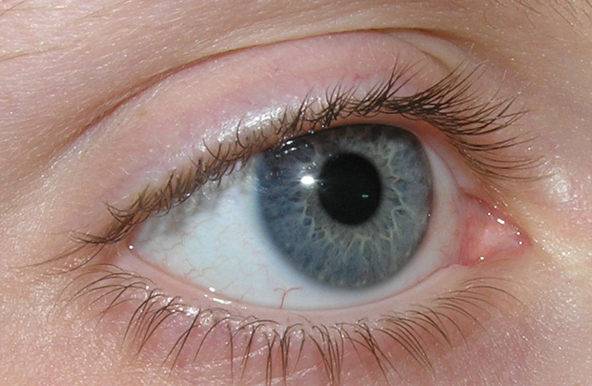
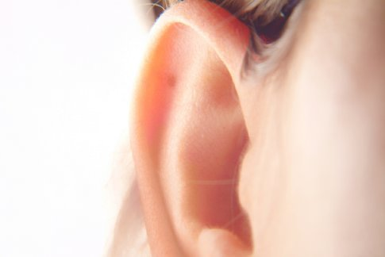
Presentation Rules to Live By
2. Humans cannot process simultaneous input through multiple senses.

Slide 5
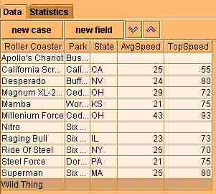
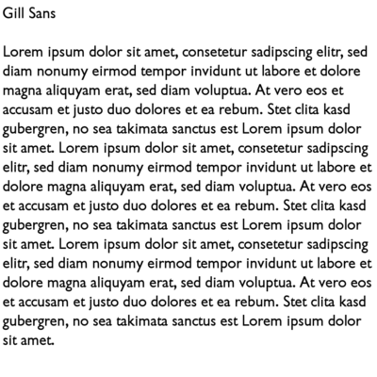
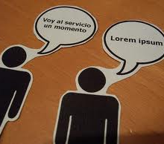
Presentation Rules to Live By
3. Text is boring. Pictures are interesting.

Slide 6
Presentation Rules to Live By
4. Do not read your notes to your audience.

Slide 7
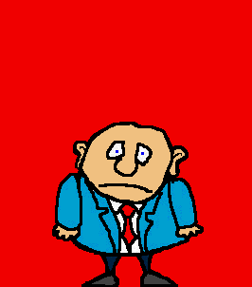
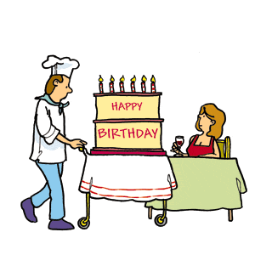
Presentation Rules to Live By
5. Do not over stimulate.

Slide 8
Presentation Rules to Live By
If you’re bored saying it …
we’re bored hearing it!

Slide 9
You Decide.
Good or Bad?

Slide 10
Have you ever wondered what became of your old computer with the black and green monitor, or your first cellphone that was the size of a loaf of bread? With people constantly upgrading their computers, TVs and cellphones, electronic waste, or e-waste, has quickly become the fastest growing component of solid waste. Compounding the problem, e-waste is often extremely toxic. Despite international agreements that prohibit the import and export of hazardous waste, shipments of broken electronic devices continue to pour into the harbours of Kenya, India and China.

Slide 11
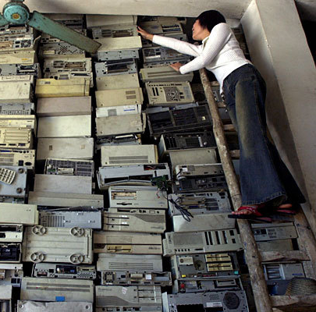
Toxic Waste in the Third World
E-waste has become the fastest growing part of solid waste.
Hazardous waste is often shipped to the third world.

Slide 12
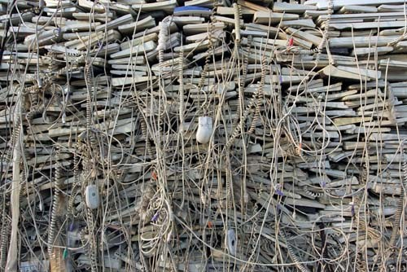

Slide 13
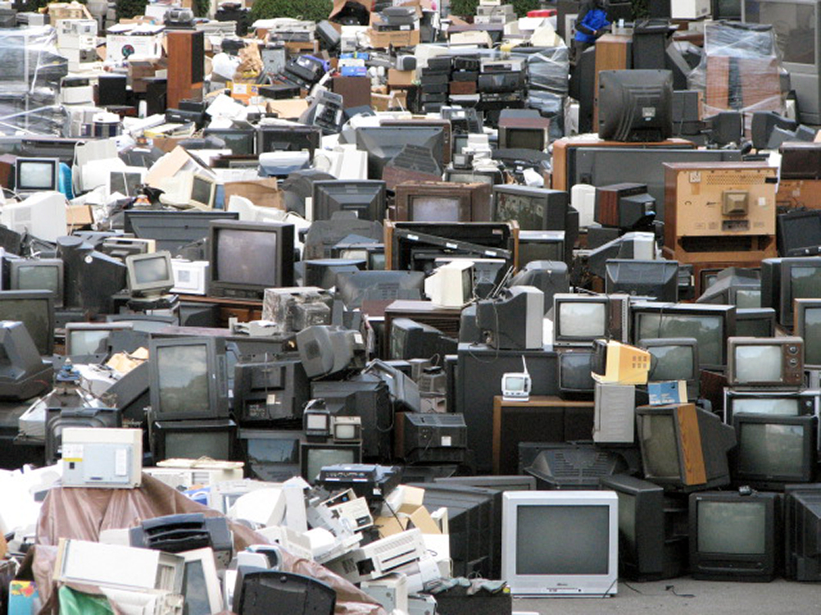

Slide 14
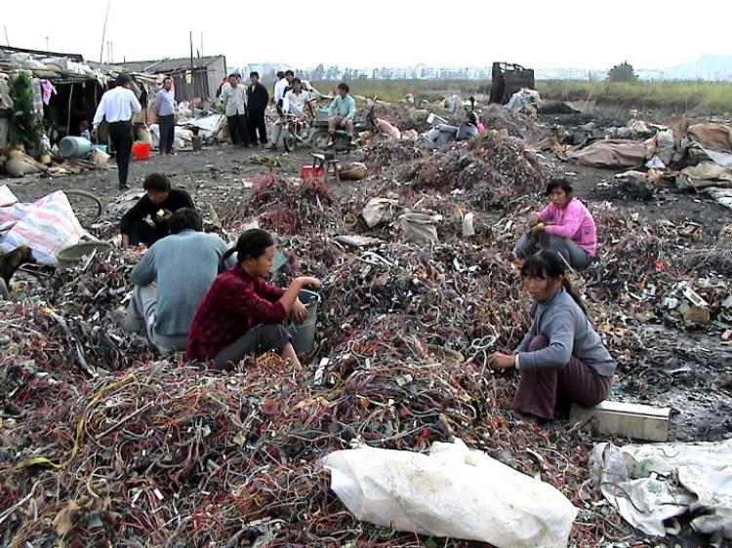

Slide 15
